Slide 1


Chapter 5
Access Control Lists
(ACLs)

Slide 2
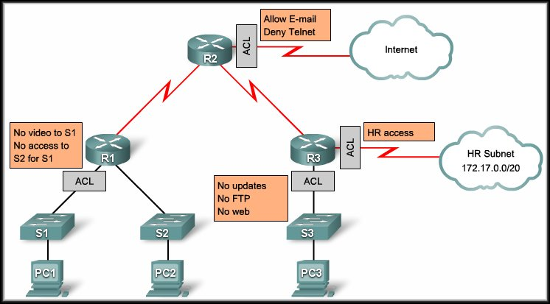
Access Control Lists
Using ACLs to Secure Networks

Slide 3
Using ACLs to Secure Networks
ACLs enable you to control traffic into and out of your network.
  Can be as simple as permitting or denying network hosts or addresses.
  Or to control network traffic based on the TCP port being used.
  To understand how an ACL works with TCP, let us look at the dialogue that occurs during a TCP conversation when you download a webpage to your computer.

Slide 4






Using ACLs to Secure Networks
A TCP Conversation:
TCP SYN “Let’s Talk”
TCP ACK “Connected!”
TCP Data “I need stuff!”
TCP ACK “Got it!”
TCP FiN/ACK “Me Too!”

Slide 5
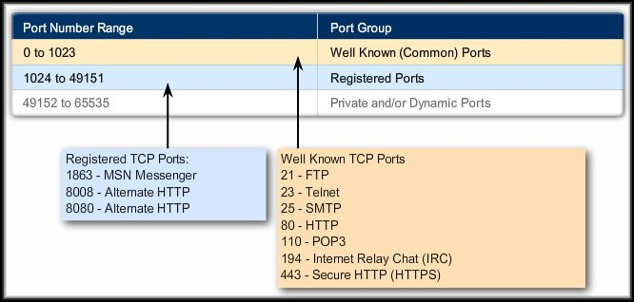
Using ACLs to Secure Networks
The TCP data segment also identifies the port matching the requested service…..TCP

Slide 6
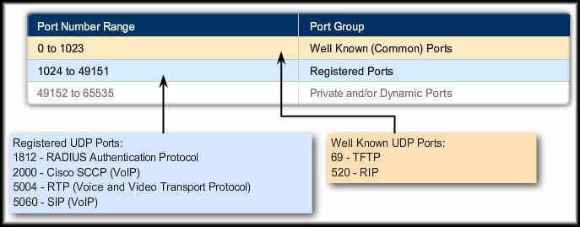
Using ACLs to Secure Networks
The TCP data segment also identifies the port matching the requested service…..UDP

Slide 7
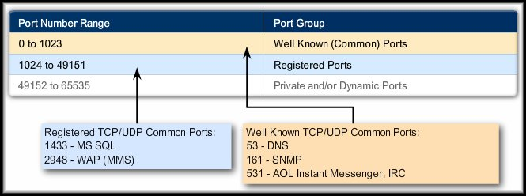
Using ACLs to Secure Networks
The TCP data segment also identifies the port matching the requested service.....Common

Slide 8
Using ACLs to Secure Networks
Packet Filtering:
  Controls access to a network by analyzing the incoming and outgoing packets and passing or halting them based on stated criteria.
    These criteria are defined using ACLs.
    An Access Control List (ACL) is a sequential list of permit or deny statements that apply to IP addresses or upper-layer protocols.

Slide 9
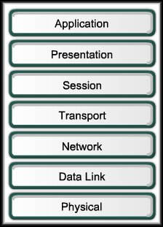
Using ACLs to Secure Networks
Packet Filtering:
  The ACL can extract the following
  information from the packet header,
  test it against its rules and make
  permit or deny decisions based on:
    Source IP address.
    Destination IP address.
    and….
    TCP/UDP source port.
    TCP/UDP destination port.
Packet Filtering works at Layer 3.

Slide 10
Using ACLs to Secure Networks
Packet Filtering:
  And….
    EIGRP Cisco's EIGRP routing protocol
    ICMP Internet Control Message Protocol
    IGMP Internet Gateway Message Protocol
    IP Any Internet Protocol
    IPINIP IP in IP tunneling
    OSPF OSPF routing protocol
    PIM Protocol Independent Multicast
      and others……

Slide 11
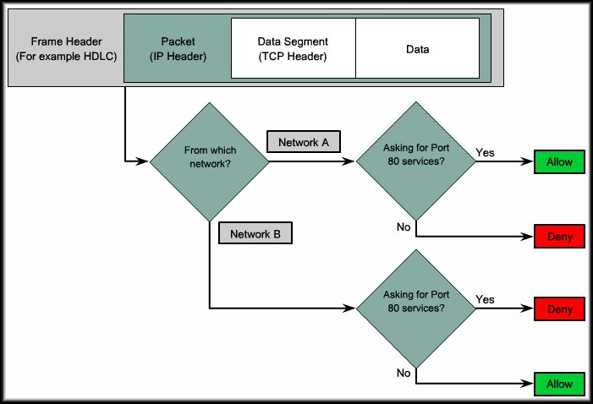
Using ACLs to Secure Networks
For Example:
Web HTML OK for Network A but not for Network B.

Slide 12
What is an ACL?
An Access Control List (ACL) is:
  A sequential list of permit or deny statements.
    Apply to IP addresses (Layer 3 header)
    Apply to upper-layer protocols (Layer 4 header).
  Controls whether a router permits or denies packets to pass through the router.
  A commonly used object in the Cisco IOS.
    Also used to select certain types of traffic to be analyzed, forwarded or processed.
      e.g. Network Address Translation (NAT), securing Telnet or SSH access to the router.

Slide 13
What is an ACL?
By default, a router does not have any ACLs.
  As each packet comes through an interface with an associated ACL:
    The ACL is checked from top to bottom.
      One line at a time.
    Matches the pattern defined in the ACL statement to the specified area of the incoming packet.
    Stops checking when it finds a matching statement.
      Takes the defined action (permit or deny).
    If no match is present, the default is to deny the packet.

Slide 14

What is an ACL?
Firewall Routers
Guidelines:
Routers between two parts of a network.
Border routers to outside networks.
Each protocol,
outbound or inbound traffic

Slide 15
The Three P’s
ACL Functions: (Why do we need them?)
  Limit network traffic and increase network performance.
  Provide traffic flow control.
  Provide a basic level of security for network access.
  Decide which types of traffic are forwarded or blocked at the router interfaces.
  Allow an administrator to control what areas a client can access on a network.
  Screen certain hosts to either allow or deny access to part of a network.
  Grant or deny user permission to access only certain types of files such as FTP or HTTP.

Slide 16
The Three P’s
One ACL per protocol:
  An ACL must be defined for each protocol enabled on the interface.
One ACL per direction:
  ACLs control traffic in one direction at a time on an interface.
    Two separate ACLs must be created to control:
      Inbound Traffic: Traffic coming into the interface.
      Outbound Traffic: Traffic leaving an interface.
One ACL per interface:
  ACLs control traffic for an interface (Fa0/0, s0/0/0).

Slide 17
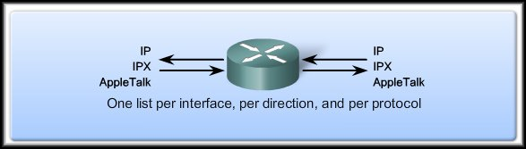
The Three P’s
Fa0/0
S0/0/0
        One Access Control List per protocol.
        One Access Control List per direction.
        One Access Control List per interface.
  How many possible ACLs?
    3 protocols X 2 directions X 2 ports
    Possibility of 12 separate lists.
      Note that the same list can be used on multiple interfaces.

Slide 18
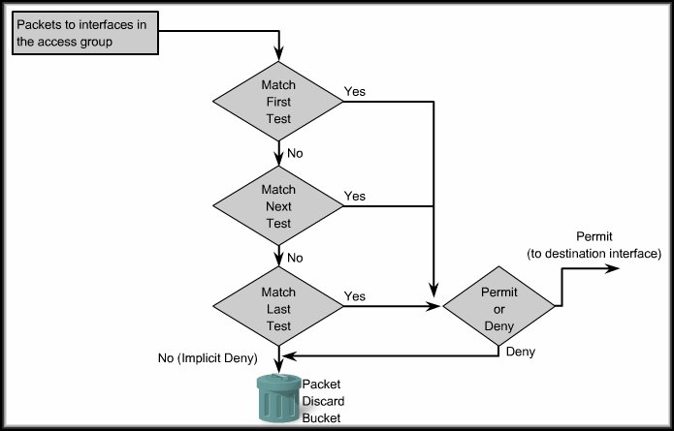
How ACLs Work
Inbound
ACL
The access group command is used to assign the list to the interface and specify the direction of the traffic to be checked.

Slide 19
How ACLs Work
Inbound
ACL
ACL statements are processed in a sequential, logical order.
The logic used to create the list and the order of the list items is very important.

Slide 20
How ACLs Work
Inbound
ACL
Implicit Deny
If a condition match is true, the packet is permitted or denied and the rest of the ACL statements are not checked.
If all the ACL statements are unmatched, an implicit deny any statement is placed at the end of the list by default.

Slide 21
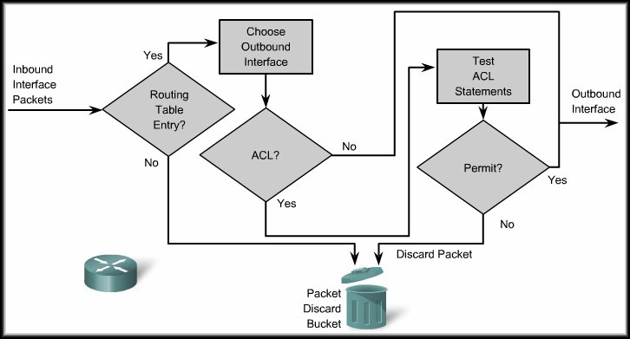
How ACLs Work
Outbound
ACL
Before a packet is forwarded to an outbound interface, the router checks the routing table.
Next, the router checks to see whether the outbound interface is grouped to an ACL (access group command).

Slide 22
How ACLs Work
Outbound
ACL
If no ACL is present, the packet is forwarded out the interface.
If an ACL is present, the packet is tested by the combination of ACL statements that are associated with that interface.

Slide 23
How ACLs Work
Outbound
ACL
Implicit Deny
The packet is either permitted (sent to the outbound interface) or denied (dropped).
If the packet does not meet any of the criteria, it is dropped (Implicit Deny).

Slide 24
How ACLs Work
Access list statements operate in sequential, logical order.
They evaluate packets from the top - down.
Once there is an access list statement match, the router skips the rest of the statements.
If a condition match is true, the packet is permitted or denied.
There can be only one access list per protocol, per interface.
There is an implicit deny any at the end of every access list.
  ACLs do not block packets that originate within the router. (i.e. pings, telnets, ssh, etc.)

Slide 25
Types of Cisco ACLs
Two types:
  Standard ACLs:
    Standard ACLs allow you to permit or deny traffic based on the source IP addresses.
    The destination of the packet and the ports involved do not matter.
    Permit all traffic from network 192.168.30.0/24 network.
    Because of the implied "deny any" at the end, all other traffic is blocked with this ACL.

Slide 26
Types of Cisco ACLs
Two types:
  Extended ACLs:
    Extended ACLs filter IP packets based on several attributes;
      Protocol type, source and/or destination IP address, source and/or destination TCP or UDP ports.
      Permits traffic originating from any address on the 192.168.30.0/24 network to any destination host port 80 (HTTP).

Slide 27

Types of Cisco ACLs
FYI:
  For either type:
    Until you become proficient at creating ACLs it may be better to always add the implied deny any at the end of your list.
    It may save you some grief.
Standard:
Extended:

Slide 28
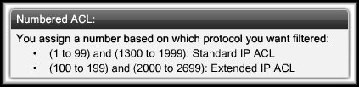
Numbering and Naming ACLs
Using numbered ACLs is an effective method for determining the ACL type on smaller networks with more homogeneously defined traffic.

Slide 29
Numbering and Naming ACLs
When configuring ACLs on a router, each ACL must be uniquely identified by assigning a number.
One group numbered 8
Multiple groups
access list 8 permit…
access list 8 permit…
access list 8 permit…
access list 8 permit…
access list 1 permit…
access list 2 permit…
access list 3 permit…
access list 4 permit…

Slide 30
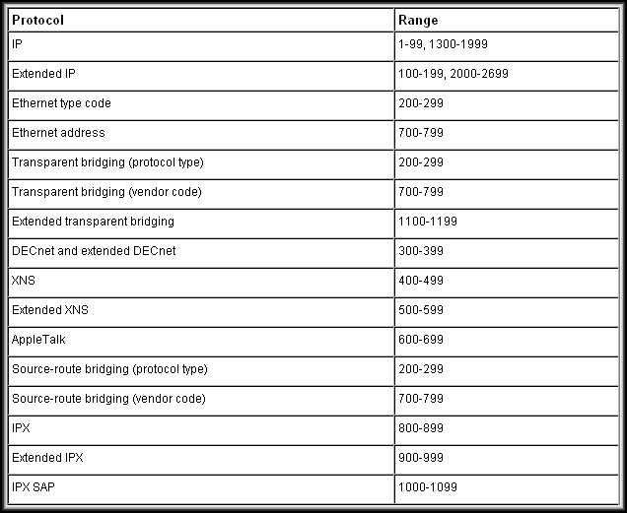
Numbering and Naming ACLs
FYI

Slide 31
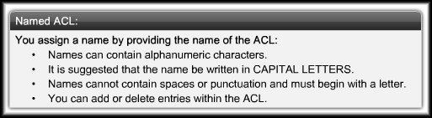
Numbering and Naming ACLs
Using named ACLs:
  A numbered ACL does not tell you the purpose of the list.
  Starting with Cisco IOS Release 11.2, you can use a name to identify a Cisco ACL.

Slide 32
Where to Place ACLs
ACLs can act as firewalls to filter packets and eliminate unwanted traffic.
  Every ACL should be placed where it has the greatest impact on efficiency.
  The basic rules are:
    Standard ACLs do not specify a destination address. Place them as close to the destination as possible.
    Extended ACLs are located as close as possible to the source of the traffic denied.
      Undesirable traffic is filtered without crossing the network infrastructure.

Slide 33
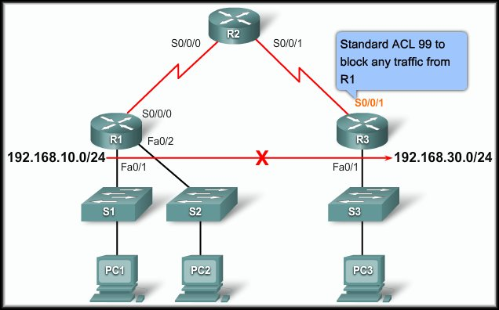
Where to Place ACLs
The administrator wants to prevent traffic originating in the 192.168.10.0/24 network from getting to 192.168.30.0/24.
Standard ACL placed closest to the destination of the traffic.

Slide 34
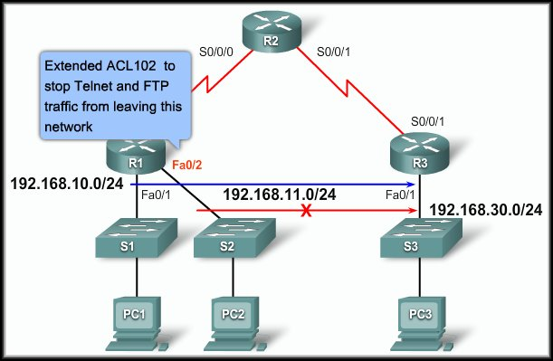
Where to Place ACLs
The administrator wants to deny Telnet and FTP traffic from 192.168.11.0/24 to 192.168.30.0/24. At the same time, other traffic must be permitted to leave 192.168.10.0/24.
Extended ACL placed closest to the source of the traffic.

Slide 35
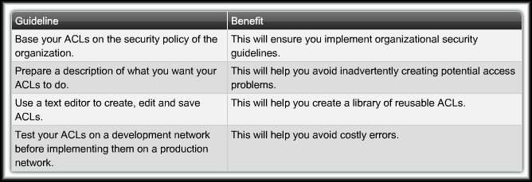
General Guidelines for Creating ACLs
ACL Best Practices:

Slide 36
Access Control Lists
Configuring Standard ACLS

Slide 37
Configuring Standard ACLs
Entering Criteria Statements:
  Traffic is compared to ACL statements based on the order that the entries occur in the router.
  The router continues to process the ACL statements until it has a match.
    You should have the most frequently used ACL entry at the top of the list.
    If no matches are found when the router reaches the end of the list, the traffic is denied because there is an implied deny for traffic.

Slide 38
Configuring Standard ACLs
Entering Criteria Statements:
  Traffic is compared to ACL statements based on the order that the entries occur in the router.
    A single-entry ACL with only one deny entry has the effect of denying all traffic.
    You must have at least one permit statement in an ACL or all traffic is blocked.

Slide 39
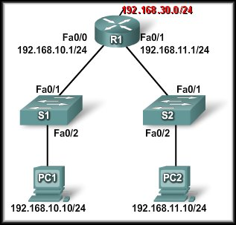
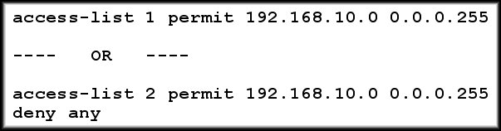
Configuring Standard ACLs
Entering Criteria Statements:
Either list would have the same affect for traffic to 192.168.30.0.
192.168.10.0 allowed,
192.168.11.0 blocked.

Slide 40
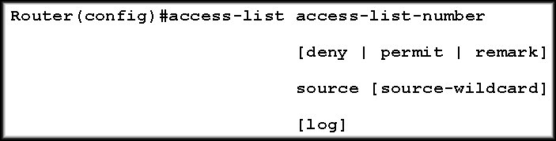
Configuring a Standard ACL
To configure a standard ACL you must:
  Create the standard ACL
  Activate the ACL on an interface.
    The access-list global configuration command defines a standard ACL with a number in the range of 1 to 99 or 1300 to 1399.

Slide 41
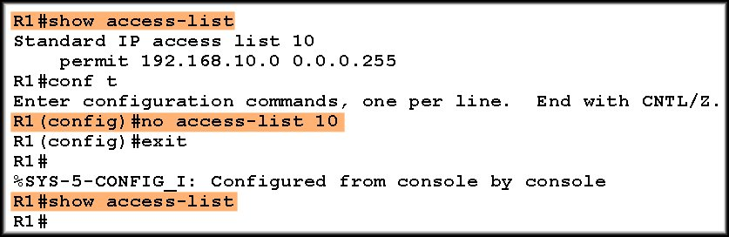
Configuring a Standard ACL
For Example:
  To create a numbered ACL designated 10 that would permit network 192.168.10.0 /24, you would enter:
  To remove an access list, use the no form of the command.

Slide 42
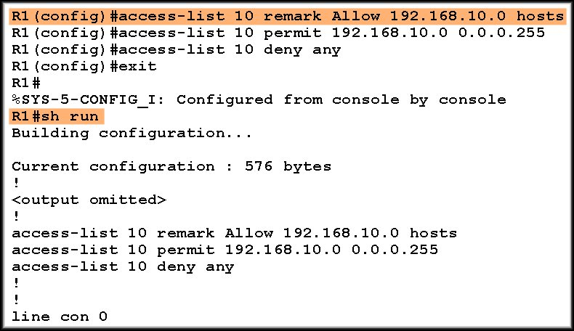
Configuring a Standard ACL
For Example:
  The remark keyword is used for documentation and makes access lists a great deal easier to understand.
Max. 100 characters
Note where the access list
appears in the
running configuration.

Slide 43
ACL Wildcard Masking
Wildcard Masking:
  ACLs statements include wildcard masks.
    (Remember OSPF network entries?)
  A wildcard mask is a string of binary digits telling the router to check specific parts of the subnet number.
    The numbers 1 and 0 in the mask identify how to treat the corresponding IP address bits.
  Wildcard masks are referred to as an inverse mask.
    Unlike a subnet mask in which binary 1 is equal to a match (network) and binary 0 is not a match (host), the reverse is true.
    It also does not have to be contiguous 1’s and 0’s.

Slide 44
ACL Wildcard Masking
Wildcard Masking:
  Wildcard masks use the following rules to match binary 1s and 0s:
    Wildcard mask bit 0:
      The corresponding bit value in the IP Address to be tested must match the bit value in the address specified in the ACL.
    Wildcard mask bit 1:
      Ignore the corresponding bit value.

Slide 45
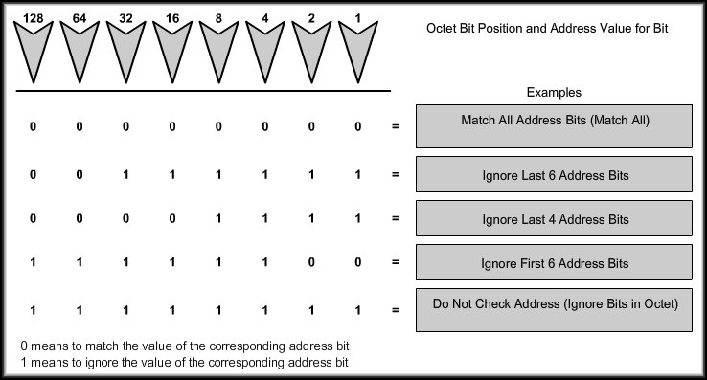
ACL Wildcard Masking
Which bits will be ignored?

Slide 46
ACL Wildcard Masking
Checking/Calculating the Wildcard Mask
Network 172.16.32.0 Subnet Mask 255.255.240.0
Subnet Mask | 255 . | 255 . | 240 . | 0
plus Wildcard Mask | 0 . | 0 . | 15 . | 255
 | 255 . | 255 . | 255 . | 255
We can calculate the Wildcard Mask using the Subnet Mask.
 | 255 . | 255 . | 255 . | 255
minus Subnet Mask | 255 . | 255 . | 240 . | 0
Wildcard Mask | 0 . | 0 . | 15 . | 255

Slide 47
Time for some Practice!
RouterB(config)#access-list 10 permit ? ?
Permit the following networks: Address / Wildcard Mask
A
172.16.0.0 255.255.0.0
172.16.0.0 0.0.255.255
B
172.16.1.0 255.255.255.0
172.16.1.0 0.0.0.255
C
192.168.1.0 255.255.255.0
192.168.1.0 0.0.0.255
D
172.16.16.0 255.255.240.0
172.16.32.0 0.0.15.255
E
172.16.128.0 255.255.192.0
172.16.128.0 0.0.63.255
Permit the following hosts:
A
172.16.10.100
172.16.10.100 0.0.0.0
B
192.168.1.100
192.168.1.100 0.0.0.0
C
All hosts
0.0.0.0 255.255.255.255

Slide 48
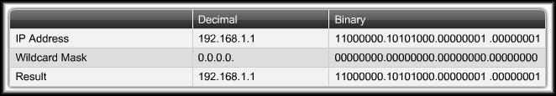
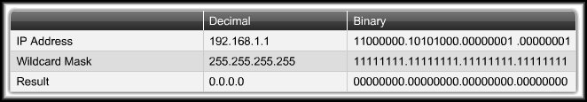
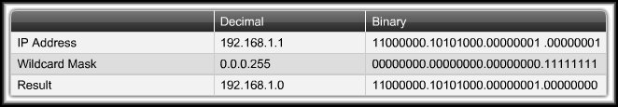
ACL Wildcard Masking
Wildcard Masking:
Just this host
Any Host
Subnet Hosts

Slide 49
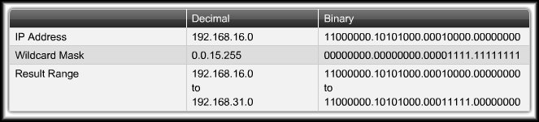
ACL Wildcard Masking
Wildcard Masking:
All IP addresses that have a match in the
first 20 bits of the address.
All Subnets 192.168.16.0 to 192.168.31.0

Slide 50
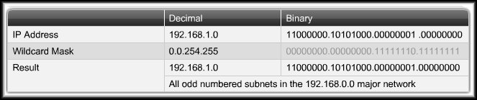
ACL Wildcard Masking
Wildcard Masking:
00000000.00000000.11111110.11111111
All IP addresses that have a match in the
first 16 bits of the address and
the last bit of the second octet.
All Odd numbered subnets in 192.168.0.0

Slide 51
ACL Wildcard Masking
Wildcard Bit Mask Keywords:
  The keywords host and any help identify the most common uses of wildcard masking.
    host:
      Used instead of 0.0.0.0 for the wildcard mask (all IP address bits must match).
    any:
      Used instead of 255.255.255.255 for the wildcard mask (accept any addresses).

Slide 52
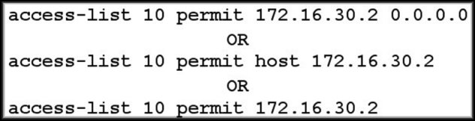
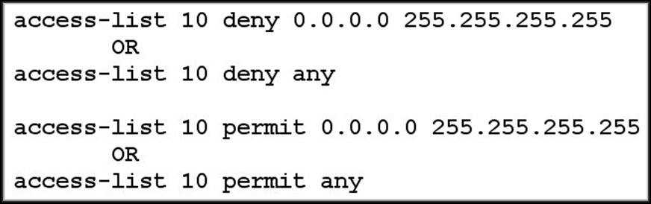
ACL Wildcard Masking
Wildcard Bit Mask Keywords:
OR
OR
OR
OR

Slide 53
Applying Standard ACLs to Interfaces
You can define ACLs without applying them but they will have no effect until they are applied to the router's interface.
  Remember……It is a good practice to:
    Apply the Standard ACLs on the interface closest to the destination of the traffic.
    Apply Extended ACLs on the interface closest to the source of the traffic.

Slide 54
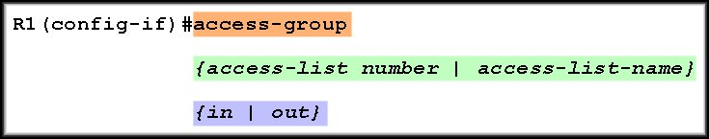
Applying Standard ACLs to Interfaces
Apply the standard ACL to an interface using the following command:
The number or name assigned during the access-list configuration.
  Consider the traffic from the router’s viewpoint.
    in: Traffic that is arriving on the interface.
    out: Traffic that has already been routed
    by the router and is leaving the interface.

Slide 55
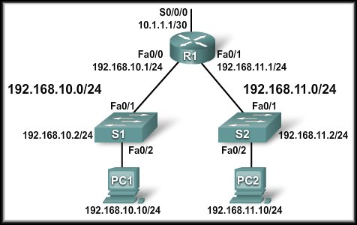
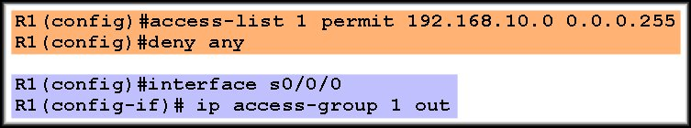
Applying Standard ACLs to Interfaces
Example 1:
  Allow only traffic from network 192.168.10.0 to exit the network on S0/0/0. Block any traffic from any other network.

Slide 56
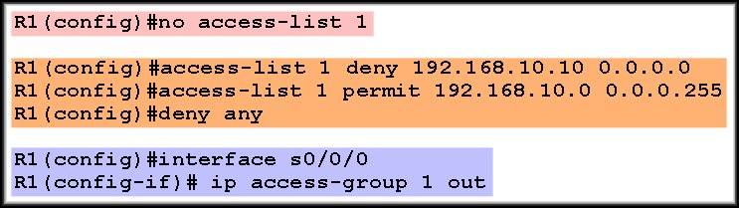
Applying Standard ACLs to Interfaces
Example 2:
  Deny any traffic from host 192.168.10.10 and allow any other 192.160.10.0 traffic to exit the network on S0/0/0. Block any traffic from any other network.

Slide 57
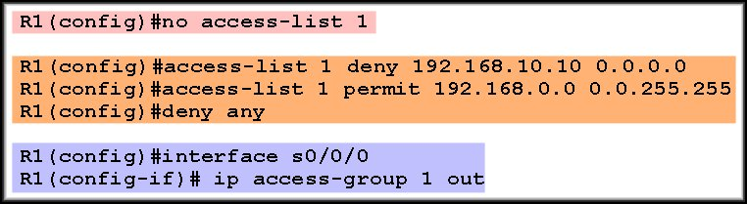
Applying Standard ACLs to Interfaces
Example 3:
  Deny any traffic from host 192.168.10.10 and allow any other subnet traffic to exit the network on S0/0/0.

Slide 58
Applying Standard ACLs to Interfaces
Using an ACL to Control VTY Access:
  If your router does not support SSH, this technique allows you to define which IP addresses are allowed Telnet access to the router EXEC process.
access-class access-list-number {in [vrf-also] | out}
List number
in – restricts incoming connections
out – restricts outgoing connections

Slide 59
Editing Numbered ACLs
When configuring an ACL, the statements are added in the order that they are entered at the end of the ACL.
  There is no built-in editing feature that allows you to edit a change in an ACL.
  You cannot selectively insert or delete lines.
  It is strongly recommended that any ACL be constructed in a text editor such as Notepad.

Slide 60
Editing Numbered ACLs
When configuring an ACL, the statements are added in the order that they are entered at the end of the ACL.
  Four Steps:
    Display the ACL using the show running-config command.
    Highlight the ACL, copy it, and then paste it into Notepad.
    Make your changes.
    Disable the access list using the no access-list command. Otherwise, the new statements would be appended to the existing ACL.
    Paste the new ACL into the configuration of the router.

Slide 61
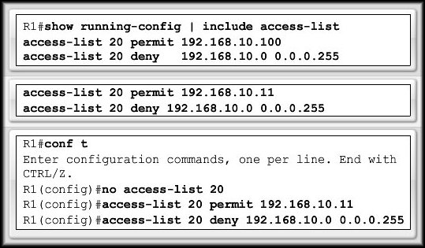
Editing Numbered ACLs
1
2
3
4
Be aware that when you use the no access-list command, no ACL is protecting your network.
  If you make an error in the new list, you have to disable it and troubleshoot the problem.

Slide 62
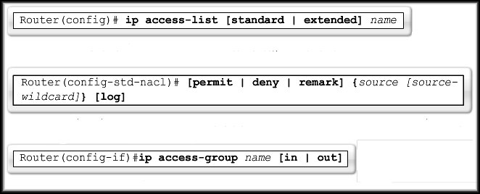
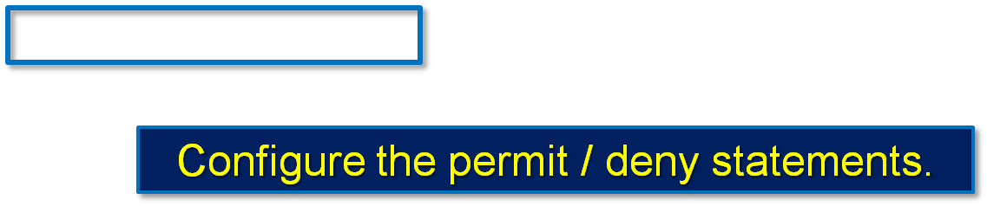
Creating Standard Named ACLs
Naming an ACL makes it easier to understand.
Must be unique and cannot start with a number.
Activate the ACL on the interface using the name.

Slide 63
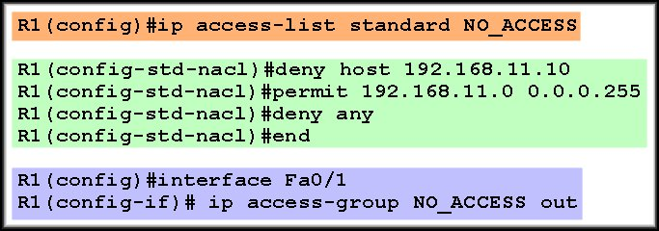
Creating Standard Named ACLs
Naming an ACL makes it easier to understand.

Slide 64
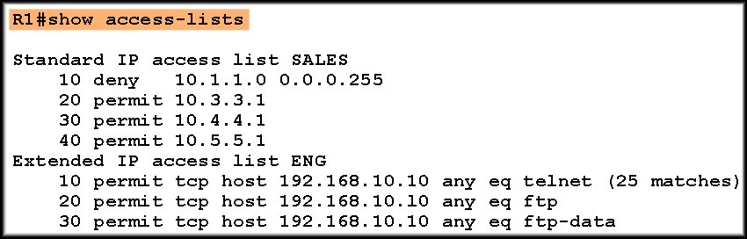
Monitoring and Verifying ACLs
Remember that there is an implied deny any
at the end of each access control list.

Slide 65
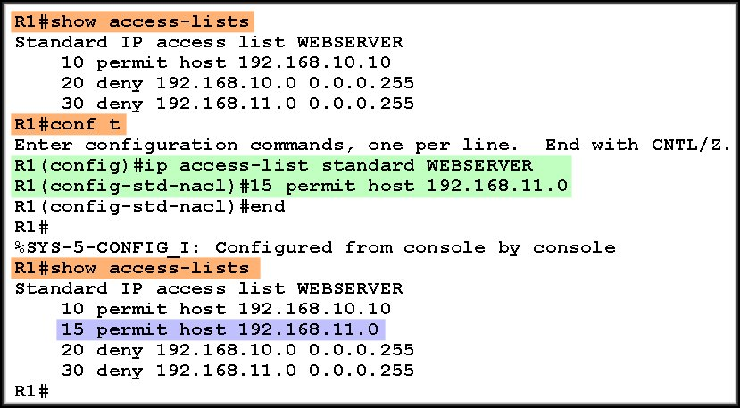
Editing Named ACLs
Named ACLs have a big advantage over numbered ACLs in that they are easier to edit.

Slide 66
Access Control Lists
Configuring Extended ACLS

Slide 67
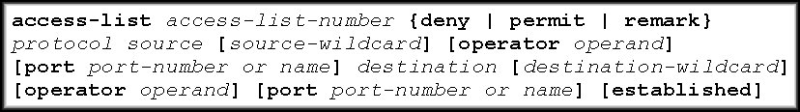
Extended ACLs
Extended ACLs are used more often than standard ACLs because they provide a greater range of control.
  Extended ACLs can check:
    Source packet address.
    Destination address.
    Protocol.
    Port number or service.
  Full Syntax:

Slide 68
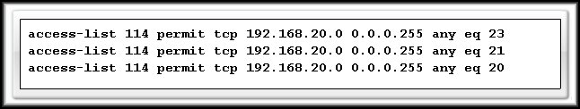
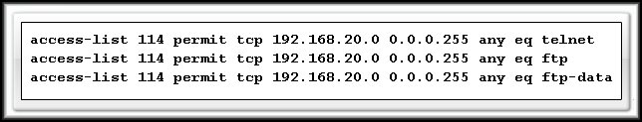
Extended ACLs
The ability to filter on protocol and port number allows you to build very specific extended ACLs.

Slide 69
Configuring Extended ACLs
Router(config)# access-list
access-list-number
{ permit | deny }
protocol
source [source-wildcard]
destination [destination-wildcard]
        operator [operand (port number / name)]
        established
As with the Standard ACL:
  The access-list command creates the list.
  The access-group command links the list to an interface and specifies the direction (in/out) that is to be checked.
  The no form of the commands removes them.

Slide 70
Configuring Extended ACLs
Router(config)# access-list
access-list-number
{ permit | deny }
protocol
source [source-wildcard]
destination [destination-wildcard]
        operator [operand (port number / name)]
        established
Range 100-199 and 2000-2699.

Slide 71
Configuring Extended ACLs
Router(config)# access-list
access-list-number
{ permit | deny }
protocol
source [source-wildcard]
destination [destination-wildcard]
        operator [operand (port number / name)]
        established
Permit:
  If this packet matches the test conditions, allow this packet to be processed.
Deny:
  If this packet matches the test conditions, drop it.

Slide 72
Configuring Extended ACLs
Router(config)# access-list
access-list-number
{ permit | deny }
protocol
source [source-wildcard]
destination [destination-wildcard]
        operator [operand (port number / name)]
        established
Can be the keyword or number of an Internet Protocol.
Keywords and numbers are available through help (?).
  To match any internet protocol (including ICMP, TCP, UDP), use the ip keyword.

Slide 73
Configuring Extended ACLs
Router(config)# access-list
access-list-number
{ permit | deny }
protocol
source [source-wildcard]
destination [destination-wildcard]
        operator [operand (port number / name)]
        established
The source and destination IP address and wildcard mask.
The format and usage of the wildcard mask is the same as in the standard ACL.
The keywords any and host can be used in the same manner as the standard ACL.

Slide 74
Configuring Extended ACLs
Router(config)# access-list
access-list-number
{ permit | deny }
protocol
source [source-wildcard]
destination [destination-wildcard]
        operator [operand (port number / name)]
        established
(Optional) compares the source or destination ports that are specified in the operand.
  Includes: lt (less than), gt (greater than), eq (equal),
  neq (not equal) and range (inclusive range).

Slide 75
Configuring Extended ACLs
Router(config)# access-list
access-list-number
{ permit | deny }
protocol
source [source-wildcard]
destination [destination-wildcard]
        operator [operand (port number / name)]
        established
If the operator and operand is positioned after the source and source-wildcard, it refers to the source port.
If the operator and operand is positioned after the destination and destination-wildcard, it refers to the destination port.

Slide 76
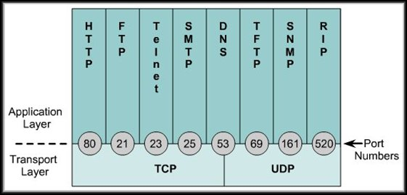
Configuring Extended ACLs
Router(config)# access-list
access-list-number
{ permit | deny }
protocol
source [source-wildcard]
destination [destination-wildcard]
        operator [operand (port number / name)]
        established
(Optional) The
decimal number or
name of a TCP or
UDP port.

Slide 77
Configuring Extended ACLs
Router(config)# access-list
access-list-number
{ permit | deny }
protocol
source [source-wildcard]
destination [destination-wildcard]
        operator [operand (port number / name)]
        established
This parameter allows responses to traffic that originates from the source network to return inbound.
With the established parameter, the router will allow only the established traffic to come back in and block all other traffic.

Slide 78
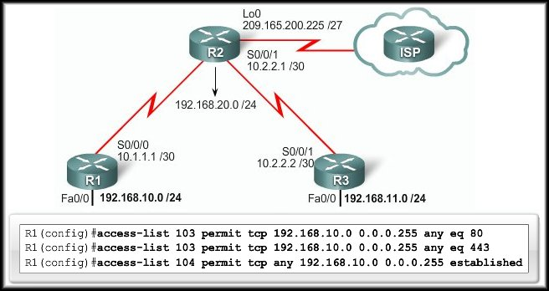
Configuring Extended ACLs
Restrict Internet access to allow only website browsing.
  ACL 103 applies to traffic leaving the network.
  ACL 104 to traffic coming into the network.

Slide 79
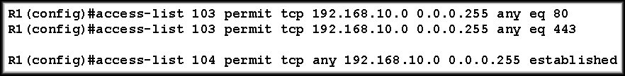
Configuring Extended ACLs
Restrict Internet access to allow only website browsing.
Command
Protocol
Operator + Operand
Number
Source
Permit/Deny
Destination
Allows traffic coming from any address on the 192.168.10.0 network to go to any destination, as long as that traffic goes to ports 80 (HTTP) and 443 (HTTPS) only.

Slide 80
Configuring Extended ACLs
Restrict Internet access to allow only website browsing.
Command
Protocol
Responses
Number
Source
Permit/Deny
Destination
The nature of HTTP requires that traffic flow back into the network. All incoming traffic, except for the established connections, is blocked from entering the network.

Slide 81
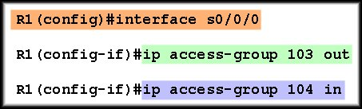
Applying Extended ACLs to Interfaces
Restrict Internet access to allow only website browsing.
  ACL 103 applies to traffic leaving the network.
  ACL 104 to traffic coming into the network.

Slide 82
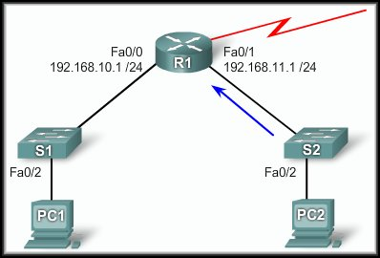
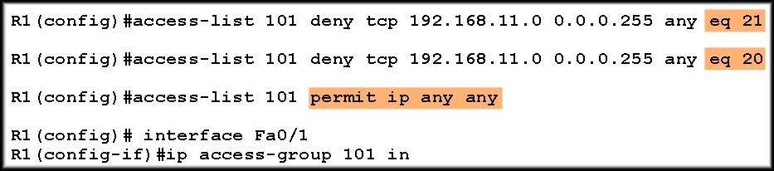
Applying Extended ACLs to Interfaces
Deny FTP:
  Deny all ftp
  from
  192.168.11.0.
eq ftp
eq ftp-data

Slide 83
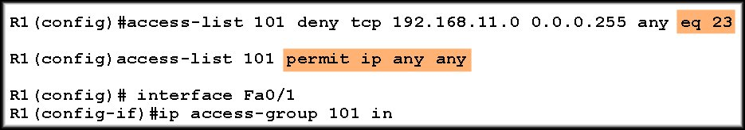
Applying Extended ACLs to Interfaces
Deny Telnet:
  Deny all telnet
  from
  192.168.11.0.
eq telnet

Slide 84
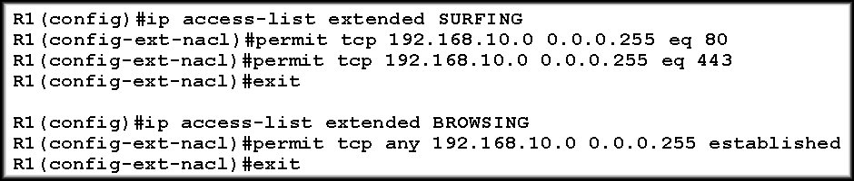

Creating Named Extended ACLs
Essentially the same way that standard names ACLs are created:
Don’t forget to apply the ACL
to all interfaces that
require the filter.

Slide 85
Access Control Lists
Configuring Complex ACLS

Slide 86
What Are Complex ACLs?
Three Types:
  Dynamic (lock-and-key):
    Users that want to traverse the router are blocked until they use Telnet to connect to the router and are authenticated.
  Reflexive:
    Allows outbound traffic and limits inbound traffic in response to sessions that originate inside the router.
  Time-based:
    Allows for access control based on the time of day and week.

Slide 87
Dynamic ACLs
Lock-and-key is a traffic filtering security feature that uses dynamic (lock-and-key) ACLs.
  Lock-and-key is available for IP traffic only.
  Dynamic ACLs are dependent on:
    Telnet connectivity.
    Authentication (local or remote).
    Extended ACLs.

Slide 88
Dynamic ACLs
Lock-and-key is a traffic filtering security feature that uses dynamic (lock-and-key) ACLs.
  Apply an extended ACL to block traffic through the router.
  Users who want to traverse the router are blocked by the extended ACL until they use Telnet to connect to the router and are authenticated.
  The Telnet connection is then dropped and a single-entry dynamic ACL is added to the extended ACL that exists.
    This permits traffic for a particular period.
    Idle and absolute timeouts are possible.

Slide 89

Dynamic ACLs
Set up username and password.
Create dynamic ACL with a 15 minute timeout.
Apply to interface.
When user connects, validated with ID and password. 5 minute idle timeout disconnects.
Detail configs in text and curriculum.

Slide 90
Reflexive ACLs
Allow IP traffic for sessions originating inside the network while denying IP traffic for sessions originating outside the network.
  The router examines the outbound traffic and when it sees a new connection, it adds an entry to a temporary ACL to allow replies back in.
  Reflexive ACLs contain only temporary entries.
  These entries are automatically created when a new IP session begins, for example, with an outbound packet, and the entries are automatically removed when the session ends.

Slide 91

Reflexive ACLs
ACL permits inbound and outbound ICMP traffic (e.g. ping, tracert).
Applied here.
Allows only TCP traffic that originated inside the network.
Detail configs in text and curriculum.

Slide 92
Time-based ACLs
Time-based ACLs are similar to extended ACLs in function, but they allow for access control based on time.
  To implement time-based ACLs:
    Create a time range that defines specific times of the day and week.
    You identify the time range with a name and then refer to it by a function.
    The time restrictions are imposed on the function itself.

Slide 93

Time-based ACLs
Telnet connection is permitted from the inside
network to the outside network on Monday,
Wednesday, and Friday during business hours.
Define the time range and give it a name.
Apply the time range to the ACL.
Apply the ACL to the interface.
Detail configs in text and curriculum.

Slide 94
Troubleshooting Common ACL Errors
Remember that ACL statements are processed in sequence from the top down. Make sure that the sequence of the ACL statements is correct.
Make sure that you permit/deny the proper protocol. Make the correct use of the TCP, UDP and IP keywords.
Always double check the use of the any keyword.
Make sure that you have applied the ACL to the correct interface and for the correct direction.
  There are specific examples of the above in the text and the curriculum.

